Slide 1
Optical Character Recognition using OpenCV
Sathish Kasilingam

Slide 2
Issues to be tackled:
Text at angles
GD&T Symbols
Auto recognition of text areas in images
Higher accuracy

Slide 3
Text at angles-Solution:
Determining the angles by using principal component analysis
The contours in the image are determined
Principal component analysis yields the directions of highest data distribution and lowest data distribution
The vector characterizing the direction of highest data distribution is selected
The angle the vector subtends with the horizontal is determined
This angle is used to determine the rotation matrix for that character set
Output: A horizontal image to be used in OCR
In Progress

Slide 4

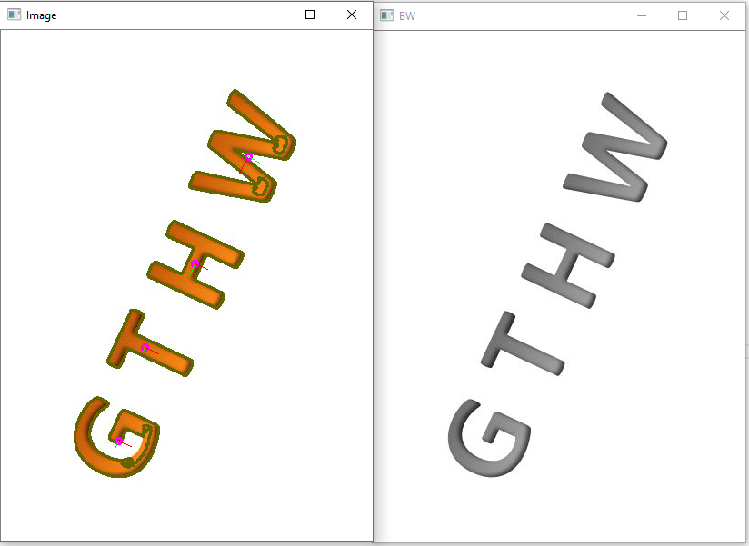
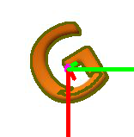
Text at angles-Solution:
Green Vector: Vector characterizing the direction of highest data distribution
Red Vector: Vector characterizing the direction of lowest data distribution

Slide 5
GD&T Symbols-Solution:
Recognizing and Printing GD&T symbols
A set is used to train the data. The needed characters can be entered in by entering their ASCII Code or Unicode.
Output: The XML files that are to be used an inputs for OCR
In Progress for all symbols

Slide 6
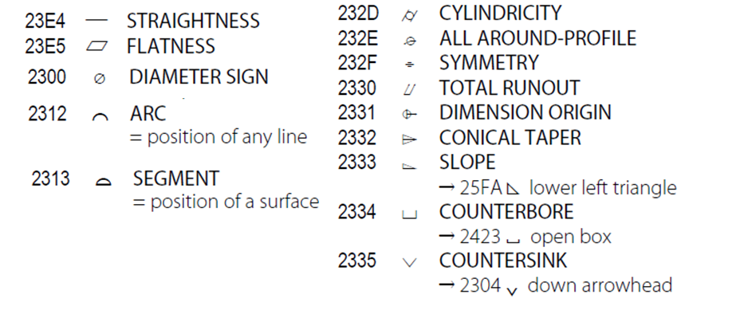
GD&T Symbols-Solution:

Slide 7
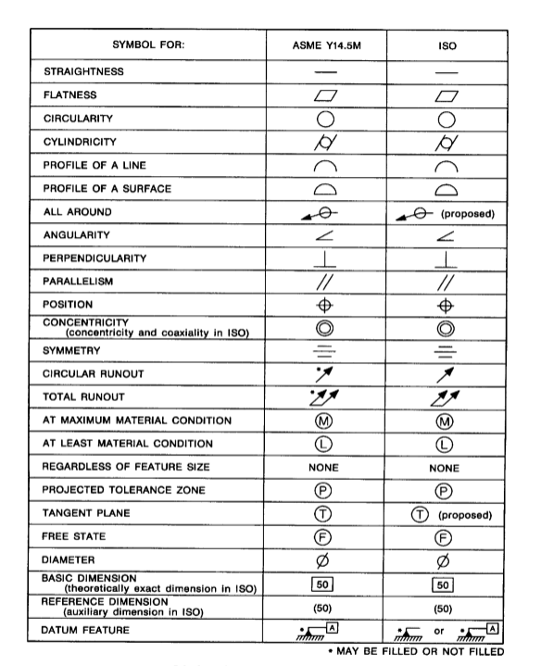
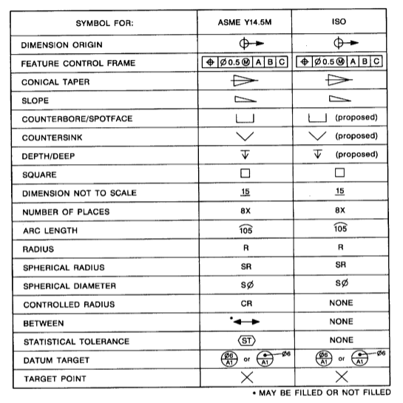
GD&T Symbols:

Slide 8
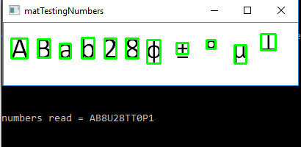
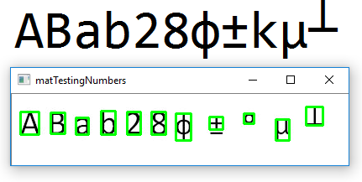
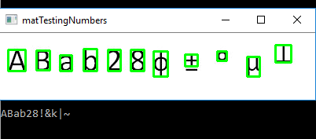
GD&T Symbols:

Slide 9
Auto recognition of text areas in images-Solution:
Determining the character sets
The contours in the image are determined.
They care compared with characters
The sets of characters are classified out of the image
The sets are sorted according to length
The region in the image is determined and then highlighted
Output:
The input image with the character sets highlighted.
Individual sets that are made horizontal and then can be used in OCR.
Nearly Done

Slide 10
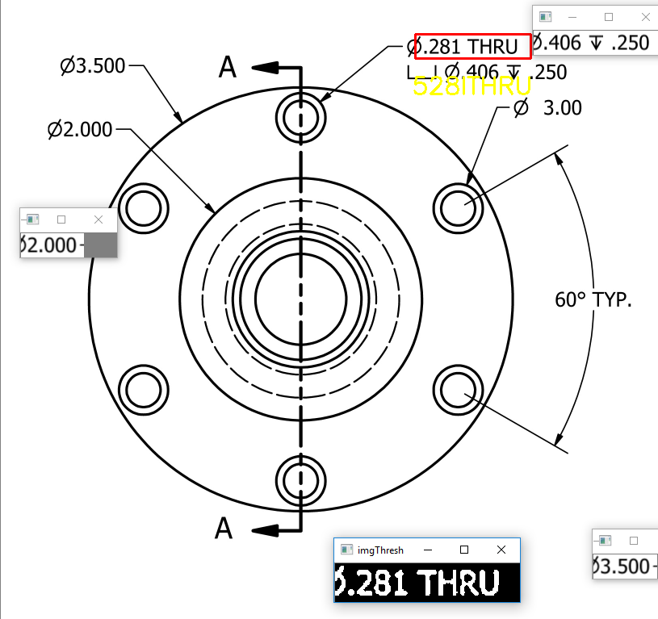
Auto recognition of text areas in images-Solution:

Slide 11
Higher Accuracy-Solution:
Loading the character sets in Unicode format
All the characters can be assigned a Unicode character
Some GD&T symbols have Unicode characters
Increasing the training dataset with more fonts and characters
Using the knn algorithm speeds up and also accurately determines characters.
Output:
An XML file that has the Unicode references of the characters.
An XML file that has the pixel intensity values of the characters.
In Progress-Requires all character sets

Slide 12
Thank You

